Slide 1
APPLIED DATA SCIENCE
PERFORMANCE TESTING AND HYPERPARAMETER TUNING
GROUP 4

Slide 2
INTRODUCTION TO PERFORMANCE TESTING AND HYPERPARAMETER TUNING:
Hyperparameter tuning with class weight optimization has proven to be efficient in handling imbalanced data [15–17].
For example, John et al. worked with machine learning algorithms and imbalanced big data and found that, regardless of the classifier or encoding technique for categorical features, classifiers with tuned hyperparameters could yield better results than those with default values when classifying highly imbalanced big data [17].

Slide 3
TESTING MODEL WITH MULTIPLE EVALUATION METRICS:
Evaluation metrics are used to measure the quality of the statistical or machine learning model. Evaluating machine learning models or algorithms is essential for any project.
There are many different types of evaluation metrics available to test a model. These include classification accuracy, logarithmic loss, confusion matrix, and others.
Classification accuracy is the ratio of the number of correct predictions to the total number of input samples, which is usually what we refer to when we use the term accuracy.

Slide 4
USES OF MULTIPLE EVALUATION METRICS:
It is very important to use multiple evaluation metrics to evaluate your model. This is because a model may perform well using one measurement from one evaluation metric, but may perform poorly using another measurement from another evaluation metric. Using evaluation metrics are critical in ensuring that your model is operating correctly and optimally
Applications of Evaluation Metrics: . Statistical Analysis . Machine Learning

Slide 5
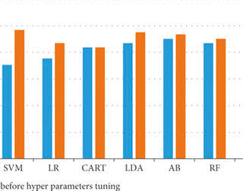
COMPARING MODEL ACCURACY BEFORE & AFTER APPLYING HYPERPARAMETER TUNING:

